Slide 1
Logging
Chapter 01

Slide 2
Log Ingestion
Process of collecting logs
Gather data from multiple systems
Centralize log information
Supports analysis workflows

Slide 3
Log Format Variability
Formats differ across systems
Fields vary in number and order
Date formats are inconsistent
Complicates data processing

Slide 4
Log Type Differences
Different log categories exist
Data included varies by system
Operating systems differ
Device types influence content

Slide 5
Securing Log Data
Logs must be protected
Prevent unauthorized changes
Preserve data integrity
Safeguard sensitive information

Slide 6
Integrity and Encryption
Use hashing for integrity
Detect log tampering
Apply encryption for protection
Secure stored data

Slide 7
Time Synchronization
Logs must align in time
Ensure consistent timestamps
Critical for correlation
Supports accurate analysis

Slide 8
NTP and Time Servers
Use NTP for synchronization
Central time sources
Keep systems aligned
Prevent time discrepancies

Slide 9
Retention Considerations
Storage is limited resource
Requires defined policies
Determine retention period
Manage long-term data use

Slide 10
Basic Terms and Concepts
Chapter 01

Slide 11
The CIA Triad
Foundation of cybersecurity
Confidentiality – Protect secrets
Integrity – Data stays unchanged
Availability – Access when needed

Slide 12
Triple A (AAA)
Three pillars of access control
Authentication – Prove identity
Authorization – Access what’s allowed
Accounting – Track all activity

Slide 13
Vulnerabilities, Threats, and Risk
Distinct terms, specific meanings
Vulnerability – System weakness
Threat – Weakness plus actor
Risk – Likelihood meets impact

Slide 14
Malware
“Malicious” + “Software”
Software with harmful intent
Viruses, worms, trojans, etc.
If malicious – it’s malware

Slide 15
Zero Day Attacks
Known only to the attacker
Undisclosed vulnerability
No patches available
Extremely dangerous exploits

Slide 16
File Formats
Chapter 01

Slide 17
File Formats Overview
Many file formats exist
Four Key types for exam
XML, JSON, YAML, and EVTX
Used in cybersecurity data

Slide 18
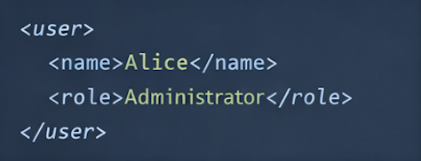
XML Structure and Characteristics
Extensible Markup Language (XML)
Based on HTML Structure
Uses opening and closing tags
Fields must match tag names

Slide 19
XML Limitations and Usage
Highly verbose format
Can be cumbersome to manage
Requires pattern matching
Widely adopted historically

Slide 20
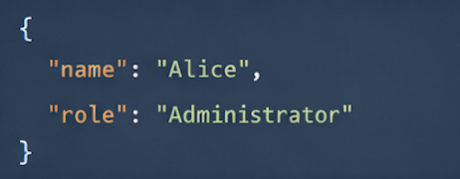
JSON Structure and Usage
JAVAScript Object Notation (JSON)
Less verbose than XML
Uses key:value pairs
Fields separated by colon

Slide 21
JSON Adoption and Parsing
Works well with JAVAScript
Supported by many languages
Easier to parse than XML
Common in automation workflows

Slide 22
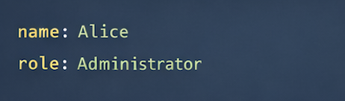
YAML Structure and Format
Yet Another Markup Language (YAML)
Less verbose than JSON
Minimal syntax structure
Uses dash-based formatting

Slide 23
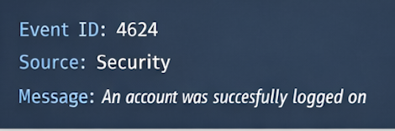
EVTX Event Log Format
Windows event log format
Successor to EVT format
XML-based structure
Used for log data

